Slide 1
Employee Attrition Analysis
Data analytics Project

Slide 2
Introduction
XYZ company which was established a few years back is facing around a 15% attrition rate for
a couple of years. And it's majorly affecting the company in many aspects. In order to
understand why employees are leaving the company and reduce the attrition rate XYZ
company has approached an HR analytics consultancy for analyzing the data they have. You
are playing the HR analyst role in this project and building a dashboard which can help the
organization in making data-driven decisions.

Slide 3
Main KPIs
Department wise & Gender
Attrition by Education
Attrition by salary
Attrition by Age & Age-Group
Attrition by Job-Role

Slide 4
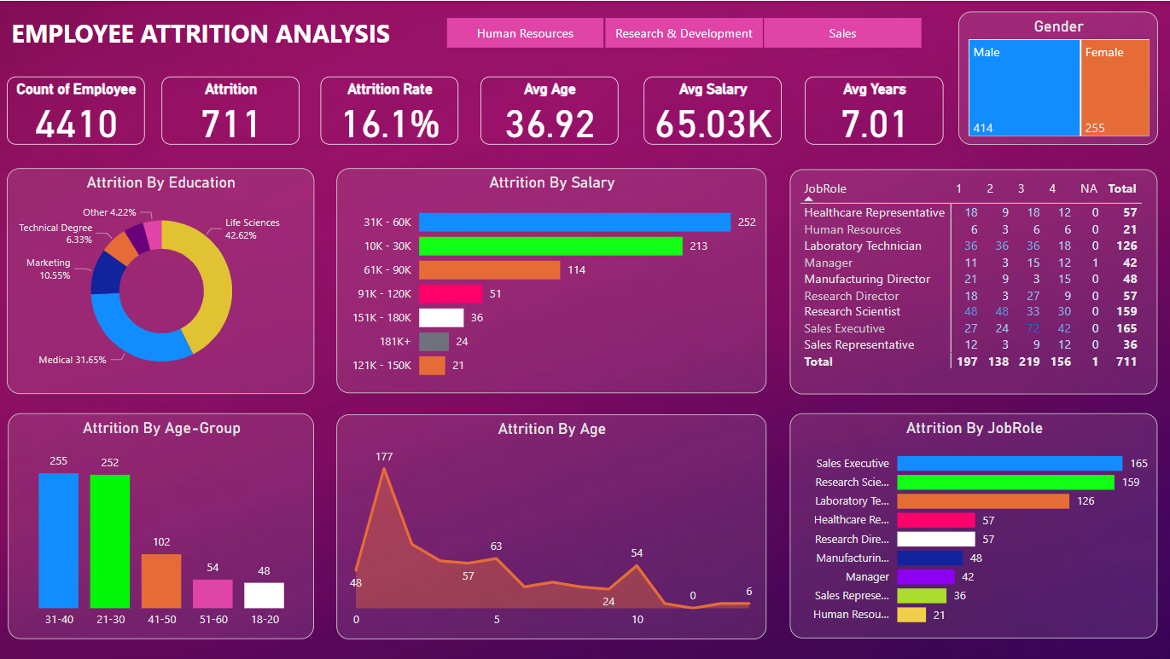
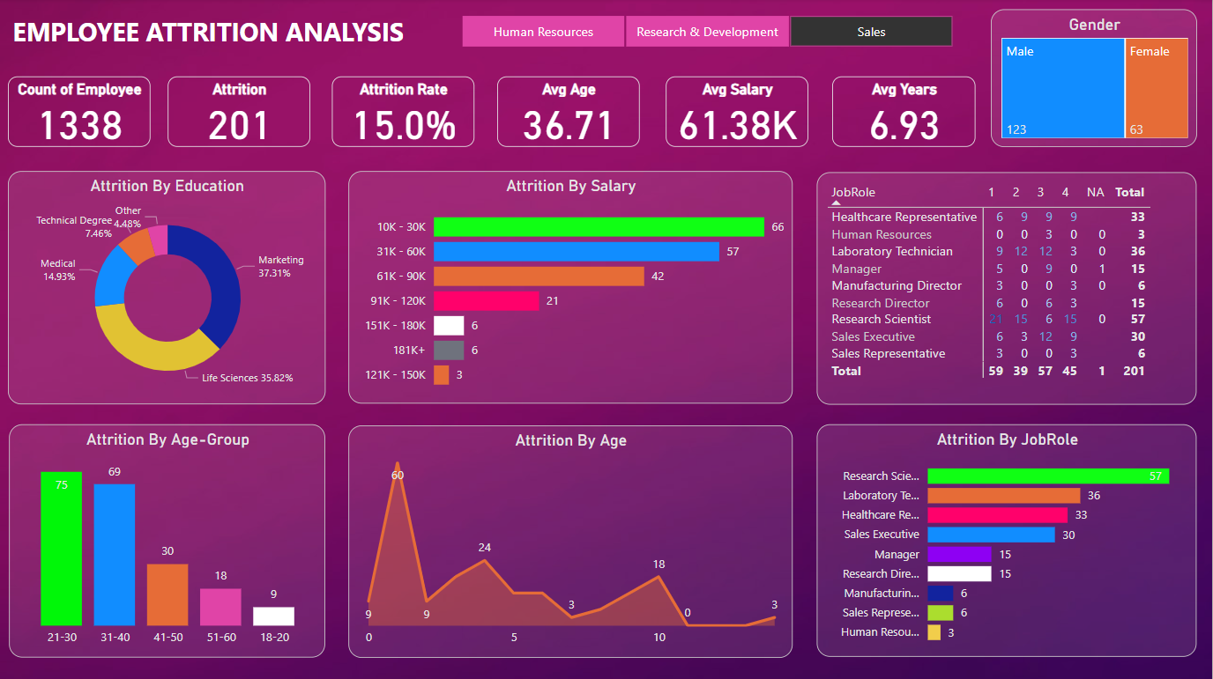
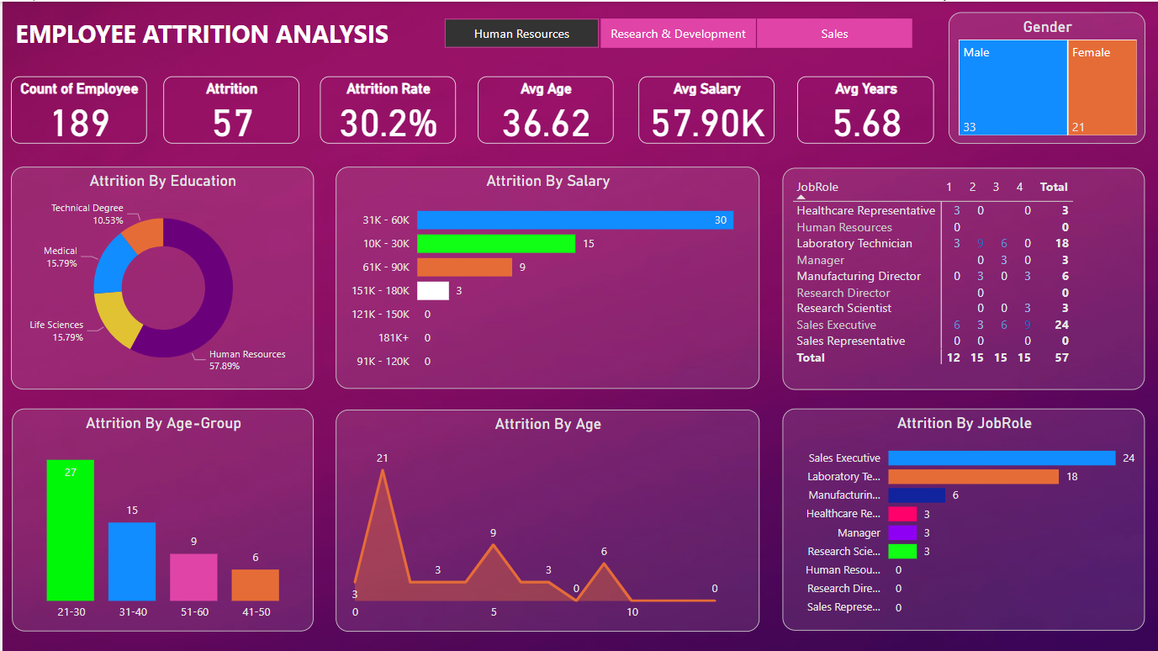
My Design

Slide 5
Thank you

